Slide 1

Truck Data Analysis
Group1
SAI Divya Gudimella
Pravallika Bobbala
Devi Prajwala Jasti
Siddharth Bramadi
Ezhilan Chinnasamy
Prajwal Jagre

Slide 2
Contents
Problem Statement
Workflow
Data in Tableau
Factors Under consideration
Analysis
Conclusion

Slide 3
Problem statement
Problem Statement:
Leveraging Big Data Hadoop Ecosystem, the project seeks to analyze truck fleet data for improved risk understanding. The goal is to enhance safety measures through real-time processing, providing decision-makers with actionable insights .
Objective:
Identify and understand the various factors that heighten the risk for drivers and subsequently offer targeted suggestions to mitigate these risks, fostering a safer driving environment.

Slide 4
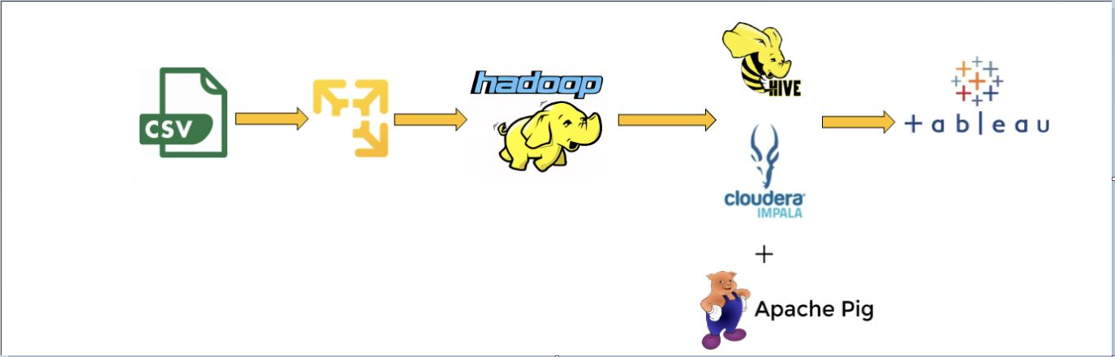
Workflow

Slide 5
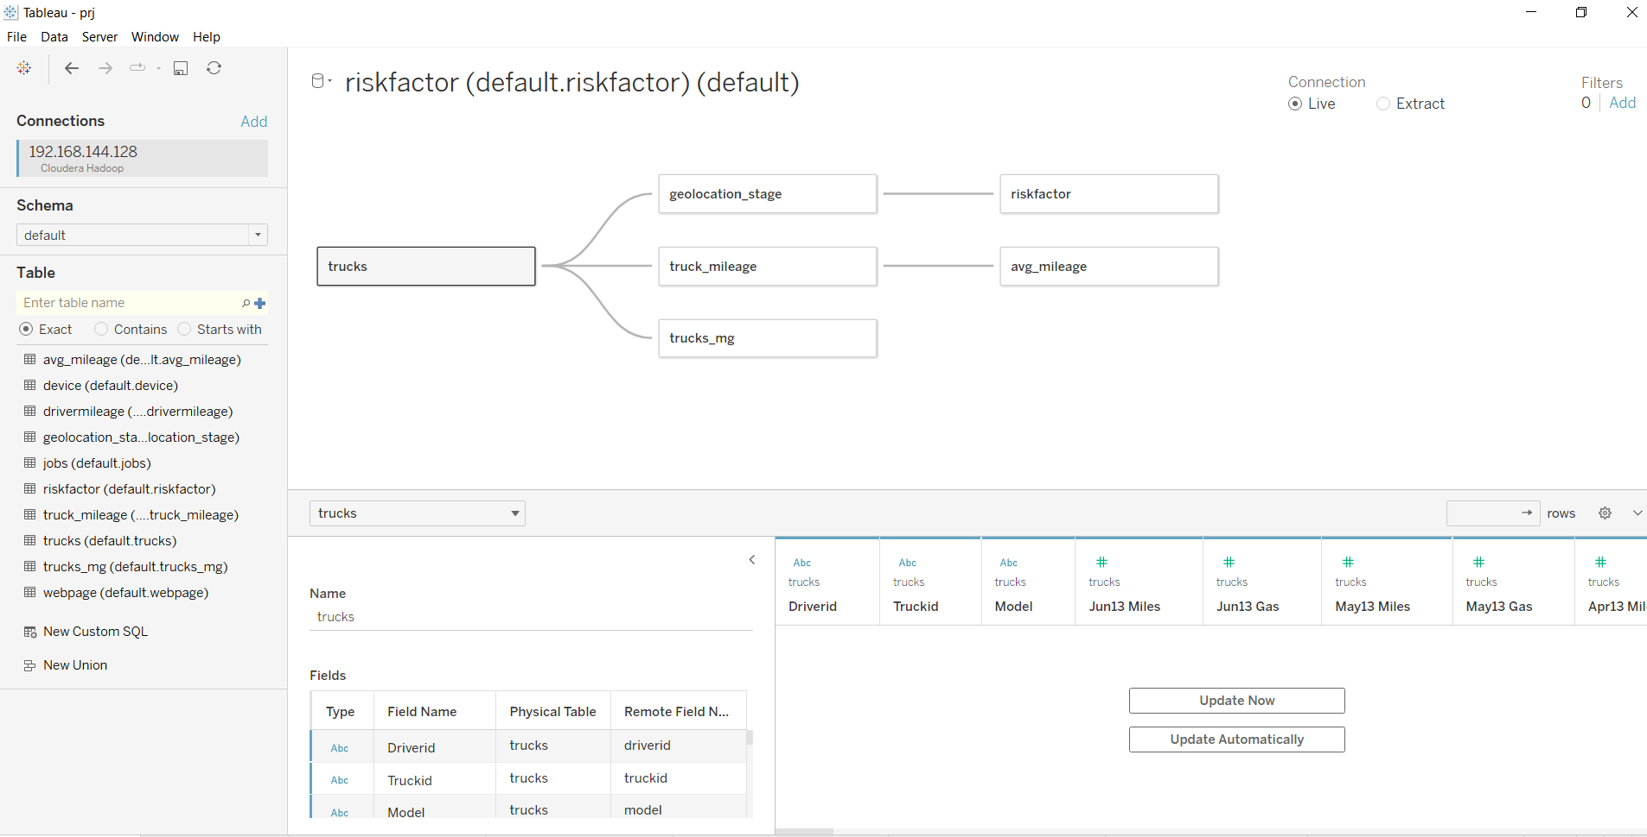
Data in Tableau

Slide 6
Factors Under Consideration
Events
Drivers
Trucks Model
Location

Slide 7
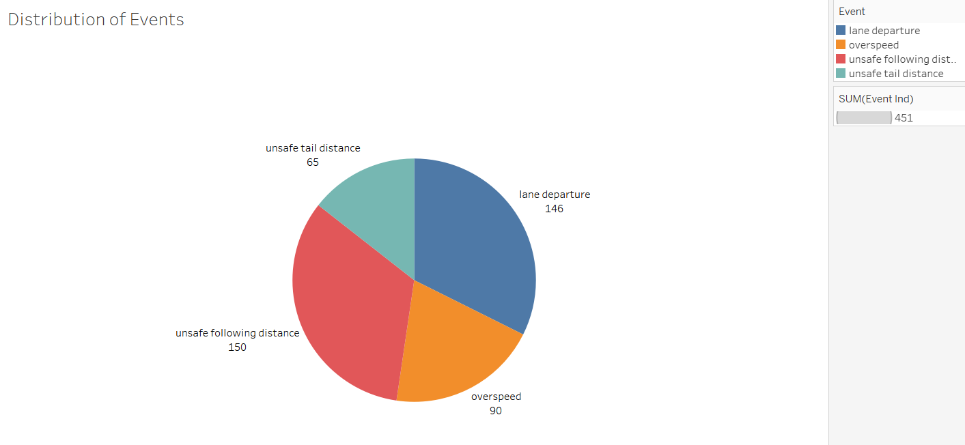
Events Analysis
Lane departure events comprise the highest proportion at 32.5%, while unsafe tail distance events represent the lowest at 14.4% among the total 451 driving events.

Slide 8
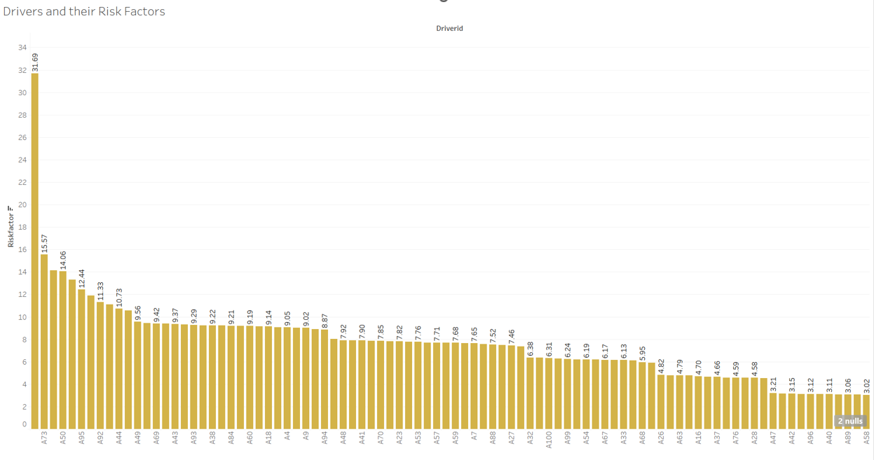
Driver Analysis
Risk Factor | Count
<7 | 46
7-15 | 51
>15 | 2
Driver risk factors are classified into three groups: >15 factors for 1.3%, 7-15 factors for a majority at 33.3%, and <7 factors for 30%. The 7-15 category, representing a substantial proportion, highlights the need for focused interventions.

Slide 9
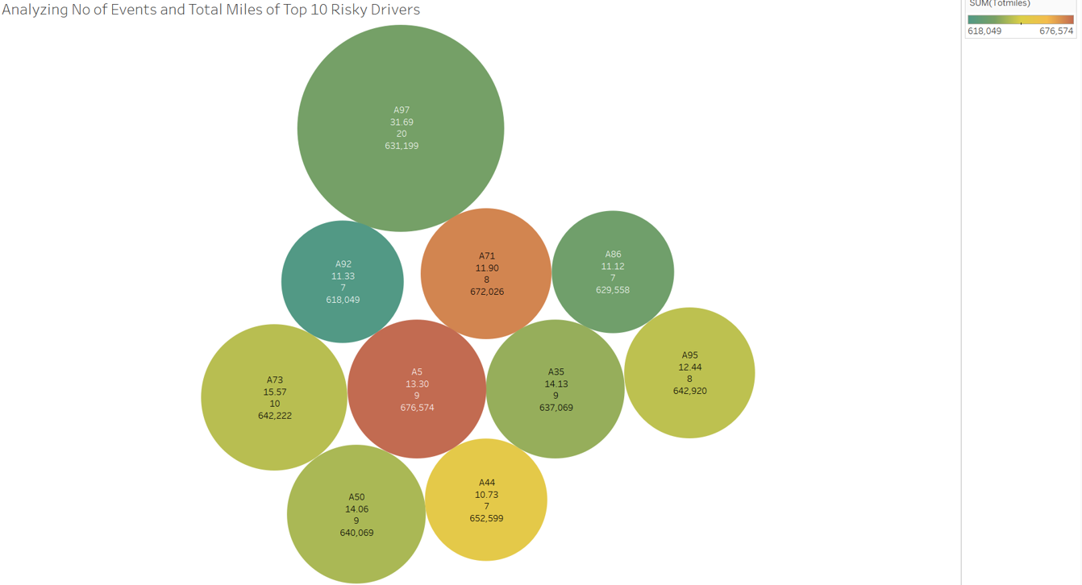
Driver Analysis
1. Driver A97 exhibits the highest frequency of events among all drivers.
2. The chart reveals that the total miles driven by the drivers and no of events do not directly correlate with their respective risk factors.

Slide 10
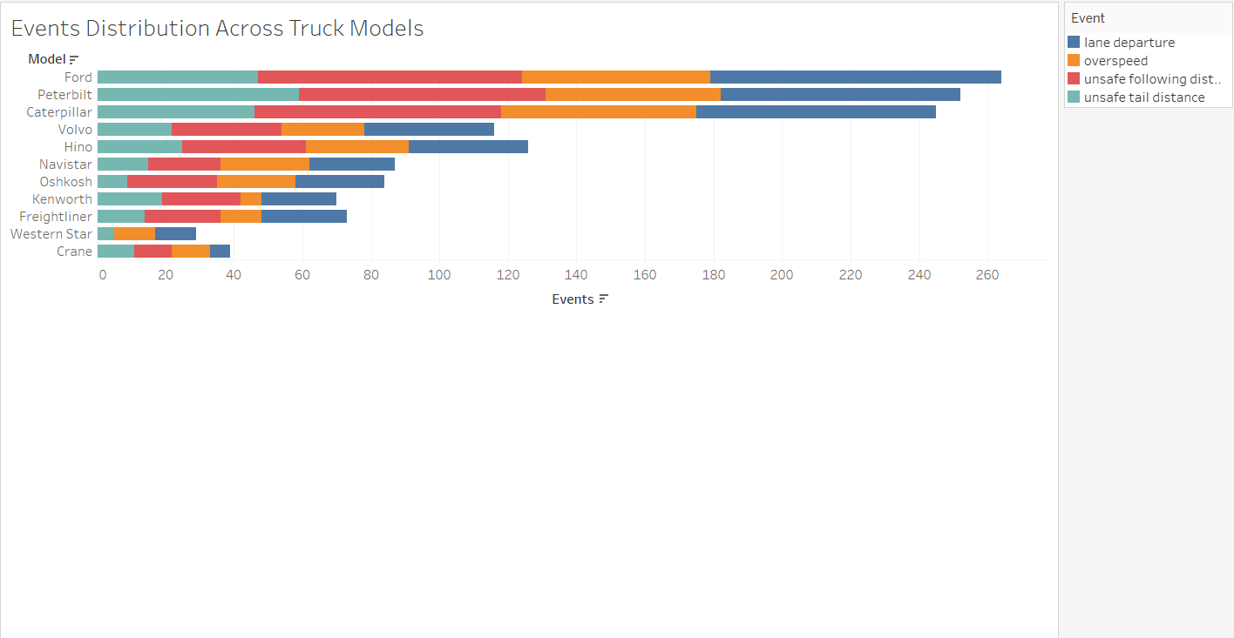
Trucks Model Analysis
Analyzing event distribution across car models reveals Ford's higher involvement in driving events, with Crane having the least frequency. This raises concerns about Ford's potential elevated risk in contributing to accidents, necessitating a focused examination of associated risk factors.

Slide 11
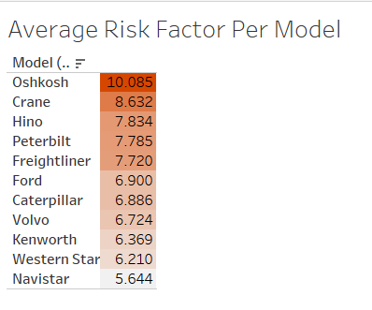
Trucks Model Analysis
Despite crane having the least number of accidents, it is noteworthy that drivers of Crane vehicles carry the second highest associated risk after Oshkosh.

Slide 12

Trucks Model Analysis

Slide 13
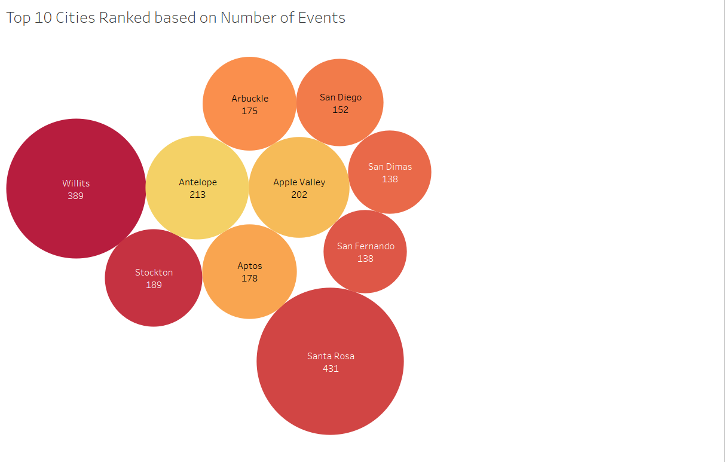
Location Analysis
The top 10 cities with the highest occurrence of events are all situated within the Northern California Region, with Santa Rosa recording the highest number of events. This insight underscores a concentration of risk in this specific geographical area.

Slide 14
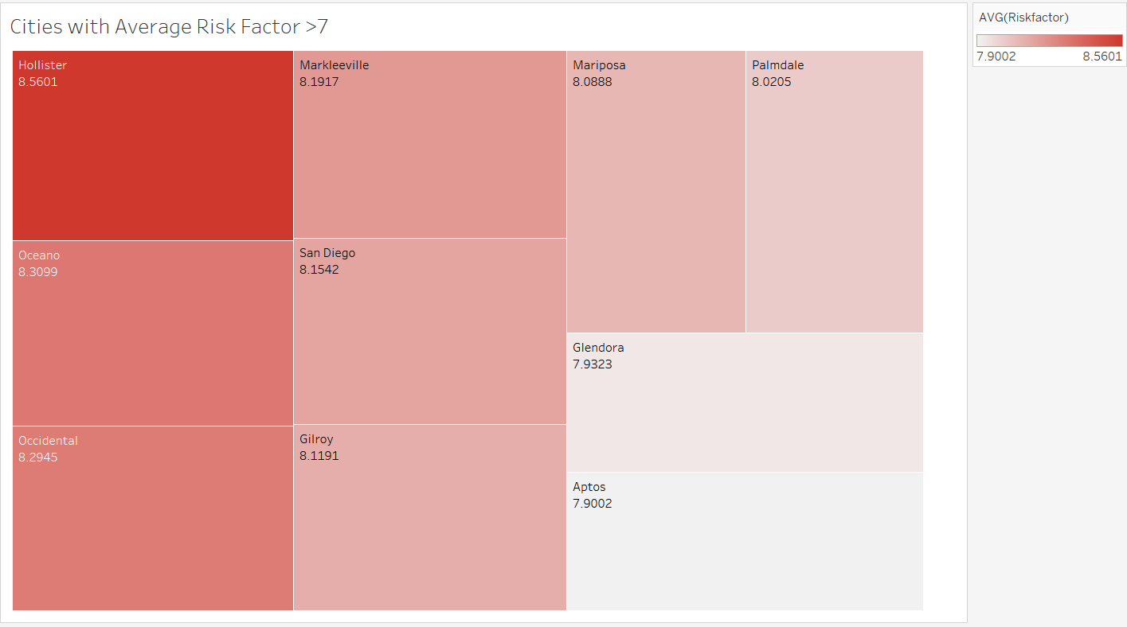
Location Analysis
Hollister holds the highest average risk factor of 8.56.

Slide 15
Conclusion
Most of the high-risk drivers fall within the range of 7 to 15, but Driver A97 stands out with an exceptionally high-risk factor of 31.69. This highlights the need for special attention and focused measures for this specific driver.
The fact that most events involve unsafe following distance and lane departure highlights a serious need for safety improvements. This suggests a focus on training drivers .
Ford, Peterbilt, and Caterpillar have seen a significant rise in reported incidents. It's recommended to be cautious or explore other options when considering the purchase of models from these manufacturers.
The Northern California Region is experiencing a high frequency of accidents, necessitating a review of driving conditions and potential improvements to roadways to address any issues.

Slide 16


